Slide 1
Our NEW Capital District Project
Children’s Miracle Network Hospitals

Slide 2
What is Children’s Miracle Network?
CMNH is a nonprofit organization that raises money to benefit hospitalized kids.
It also increases awareness of its member hospitals.
All CMN Hospitals contributions directly benefit hospitals, helping to purchase up-to-date equipment, train staff, conduct life-saving research, implement outreach programs and provide health care for children whose parents can’t afford to pay.

Slide 3
Where are the CMN Hospitals Located in the Capital District?
John’s Hopkins Children’s Center -- Baltimore, Maryland
Children's National Health System -- Washington D.C
University of Virginia-- Charlottesville, Va
Children's Hospital of The King's Daughters -- Norfolk, Va
Children’s Hospital of Richmond at VCU -- Richmond, Va
Centra Lynchburg General and Virginia Baptist Hospitals -- Lynchburg, Va
Carilion Children’s -- Roanoke, Va

Slide 4
What are project ideas for Key Clubs?
Stalling for Spare Change: The more money the school raises, the longer class is stalled for that day. So classes will be delayed 1 second for every $.50 raised. If the school raises $1,000, that is 2,000 seconds (33 minutes and 33 seconds).
Music Lessons for Miracles: Kids that can play certain instruments offer to teach other students for a donation to the hospital.
Fashion Show/Auction: Get clothes donated by students, families, etc. (like prom dresses, or even regular clothes) and have patients from hospitals model them. Another version of this could be a “Men’s Fashion Show.”
Movies for Miracles: Host a movie night in the gym or on the football field. You can’t require tickets or donations for the movie (copyright laws), however you can ask for donations and/or sell concessions for cash. A school could also do a movie making contest where each entry pays an entrance fee and then attendees are judges.

Slide 5
What are more project ideas?
Pageant for Miracle Kids.
Cook off/eating contest.
Making and selling trinkets like bracelets and earrings.
Sports tournament
Soccer
Dodgeball
Tennis
5K fun run.
Miracle Day at a local
Pillow Decorating
Grippy Sock Making

Slide 6
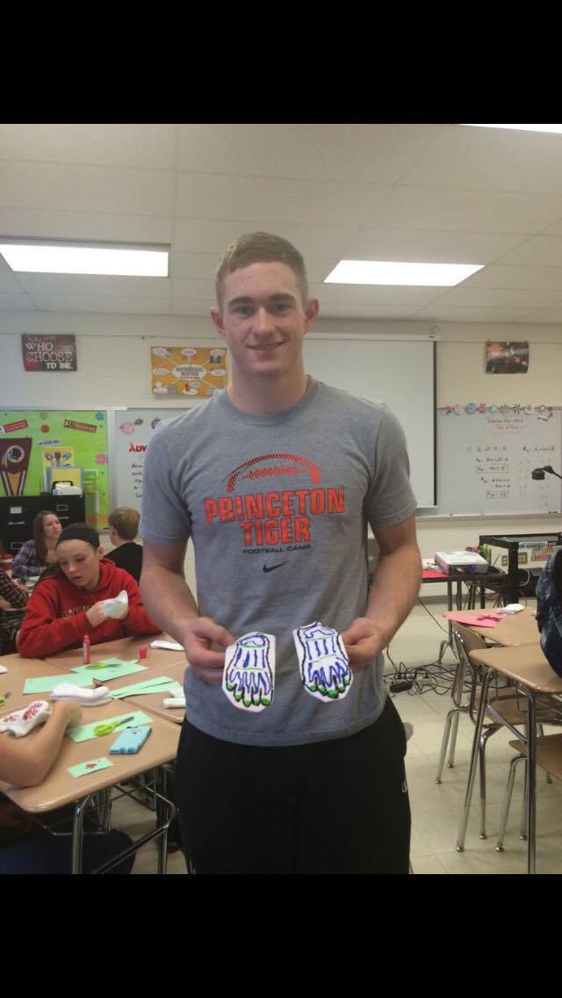
Division 7A’s Grippy Sock Making
The sock project is so easy and a lot of fun! We got white socks and a bunch of puffy paint from Walmart and then had a blast making all sorts of designs on the bottom of them for the kids at the hospital! We had so much fun making them, I can only imagine how happy the kids at the hospital were to get them! ~ LTG 7A Anna Sepanic

Slide 7
Children’s Miracle Network Hospital Bands
Don’t forget to order your FREE Miracle Band at
http://give.childrensmiraclenetworkhospitals.org

Slide 8
Where can I get more information about CMNH?
Check out the CMNH website, and the Capital District Website for more information!
www.capitaldistrictkeyclub.org
www.give.childrensmiraclenetworkhospitals.org

